Slide 1
Regularization
UIUC ECON 490: Applied Machine Learning in Economics

Slide 2
Fitting Data
It’s just optimization

Slide 3
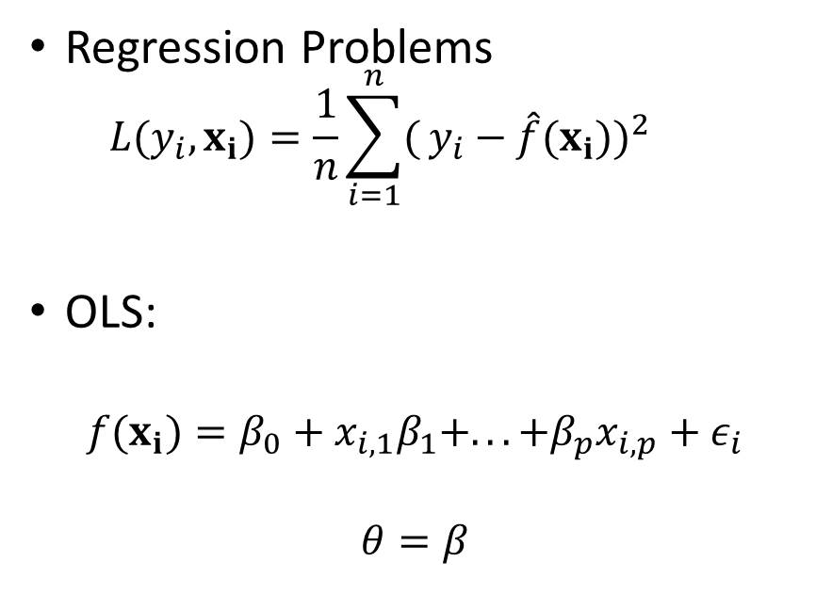

All of Machine Learning/Econometrics/Statistics
$${\text{min}}_{θ} L(y_{i},x_{i})$$
Regression Problems
$$L(y_{i},x_{i})=\frac{1}{n}\sum_{i=1}^{n}{(}y_{i}−\hat{f}(x_{i}))^{2}$$
OLS:
$$f(x_{i})=β_{0}+x_{i,1}β_{1}+...+β_{p}x_{i,p}+ε_{i}$$
$$θ=β$$
Classification Problems
$$L(y_{i},x_{i})=\frac{1}{n}\sum_{i=1}^{n}{𝕀}\{y_{i}≠\hat{f}(x_{i})\}$$
KNN
$$θ=k$$

Slide 4

Ridge Regression
$${\hat{β}}^{ridge}=\text{argmin} {\left(\sum_{i=1}^{n}{y_{i}}−β_{0}−\sum_{j=1}^{p}{x_{i,j}}β_{j}\right)}^{2}$$
subject to
$$\sum_{j=1}^{p}{β_{j}^{2}}≤t$$
or equivalently
$${\hat{β}}^{ridge}=\text{argmin} {\left(\sum_{i=1}^{n}{y_{i}}−β_{0}−\sum_{j=1}^{p}{x_{i,j}}β_{j}\right)}^{2}+λ\sum_{j=1}^{p}{|}β_{j}|^{2}$$

Slide 5
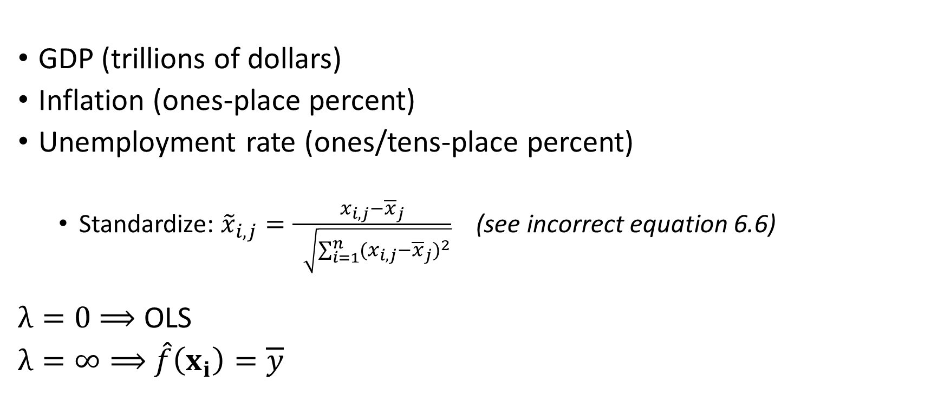
A Note on Variables and $λ$
GDP (trillions of dollars)
Inflation (ones-place percent)
Unemployment rate (ones/tens-place percent)
Standardize: ${\tilde{x}}_{i,j}=\frac{x_{i,j}−{\overline{x}}_{j}}{\sqrt{\sum_{i=1}^{n}{(}x_{i,j}−{\overline{x}}_{j})^{2}}}$ (see incorrect equation 6.6)
$λ=0$ $⟹$ OLS
$λ=∞⟹$ $\hat{f}\left(x_{i}\right)=\overline{y}$

Slide 6

Lasso Regression
$${\hat{β}}^{lasso}=\text{argmin} {\left(\sum_{i=1}^{n}{y_{i}}−β_{0}−\sum_{j=1}^{p}{x_{i,j}}β_{j}\right)}^{2}$$
subject to
$$\sum_{j=1}^{p}{|}β_{j}|≤t$$
or equivalently
$${\hat{β}}^{lasso}=\text{argmin} {\left(\sum_{i=1}^{n}{y_{i}}−β_{0}−\sum_{j=1}^{p}{x_{i,j}}β_{j}\right)}^{2}+λ\sum_{j=1}^{p}{|}β_{j}|$$

Slide 7
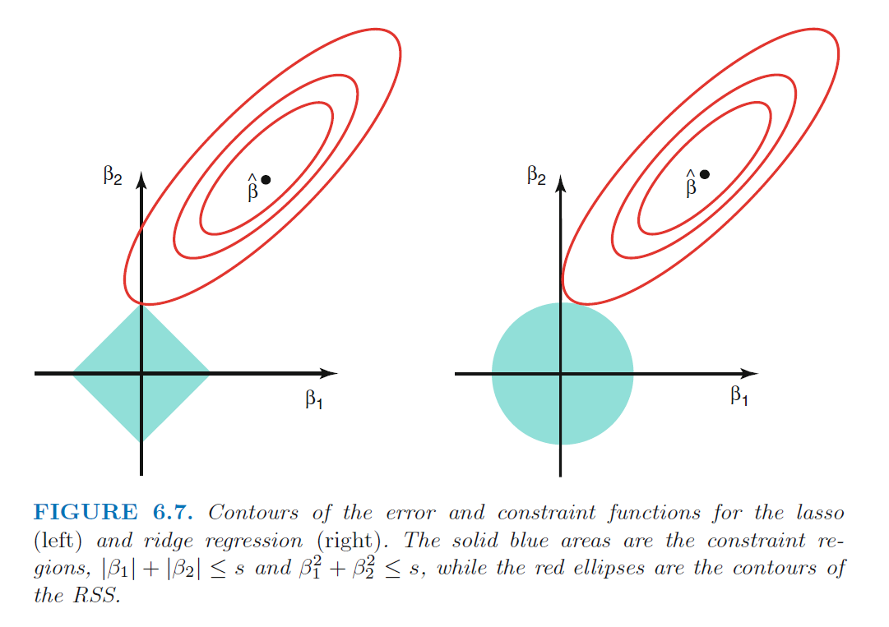
Ridge vs. Lasso

Slide 8
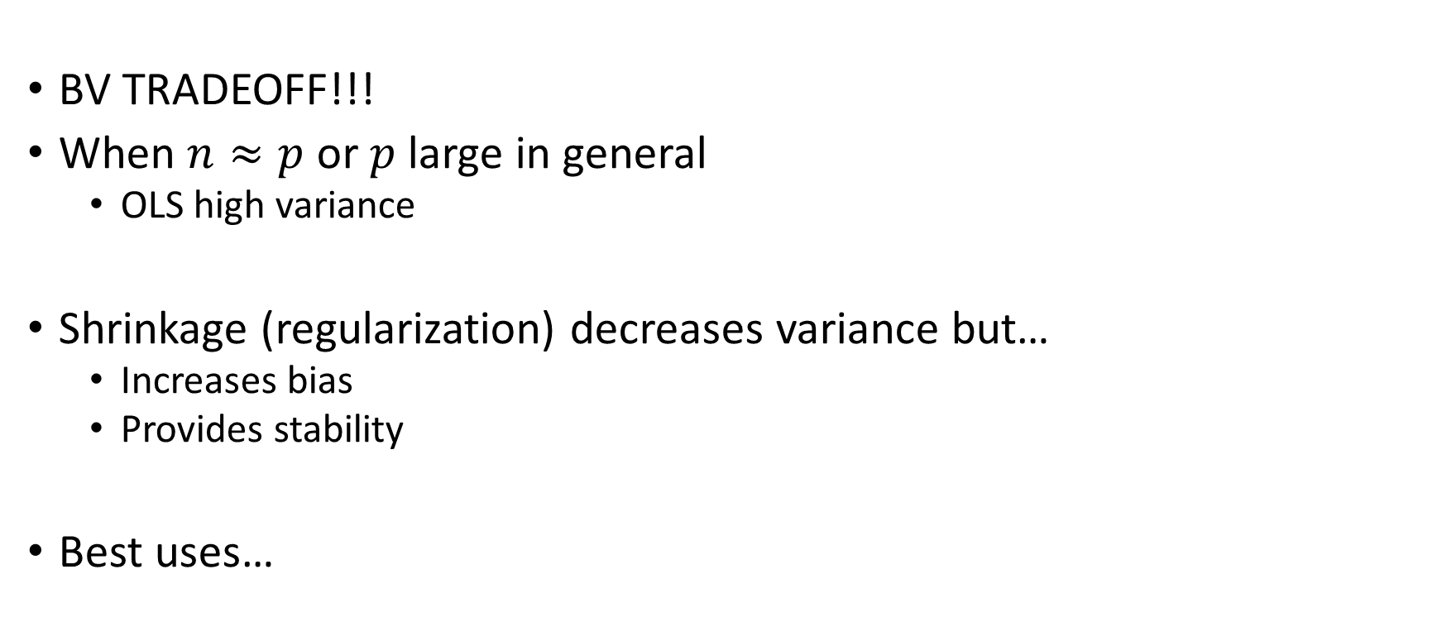
Hold up. Why do we want to do this?
BV TRADEOFF!!!
When $n≈p$ or $p$ large in general
OLS high variance
Shrinkage (regularization) decreases variance but…
Increases bias
Provides stability
Best uses…

Slide 9
Ridge vs Lasso Part 2
Ridge – shrinks
When we believe most parameters are important predictors
Lasso – selects
When we believe some parameters are unimportant predictors
Run OLS again for reduced bias
Compare with sample-splitting

Slide 10
Choosing $λ$
CROSS-VALIDATION!!!

Slide 11
To Do
Complete
Lab 6.6
Read
Chapter 6.3, 6.4

